Slide 1



SMART INDIA HACKATHON 2025
TITLE PAGE
PROBLEM STAEMENT ID - SIH25050
PROBLEM STAEMENT TITLE - Smart Traffic Management
System for Urban Congestion
THEME - Transportation & Logistics
PS CATEGORY - Software
TEAM ID - 138
TEAM NAME - @XEN!TH

Slide 2

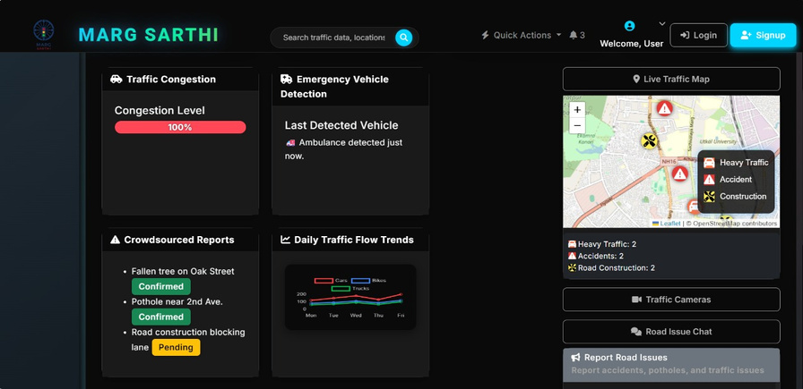
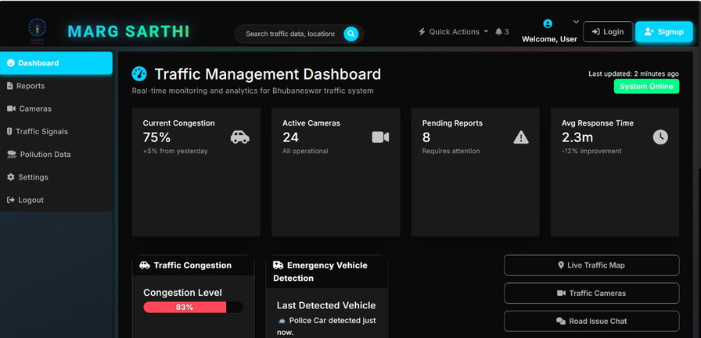
MARG SARTHI
@XEN!TH
WHERE ROADS MEET INTELLIGENCE
"Imagine you’re stuck at a red light . Traffic is jammed, an ambulance is honking behind you, and potholes slow everything further. Current apps like Google Maps can only show traffic density — they can’t clear a path, predict jams, or involve citizens. This is where Mārg Sārthi comes in."
Proposed Solution
Mārg Sārthi is an AI-powered Intelligent Smart Traffic Management (ISTM) system designed for Indian cities. It predicts congestion, adapts signals in real time, prioritizes ambulances, monitors road health, and engages citizens through reporting & rewards. It integrates real-time camera feeds, IoT sensors, V2V communication, and citizen reporting to predict and prevent congestion.
Traffic optimization
Long waits → Adaptive real-time signals
Jams → LSTM congestion forecasting (2–4 km ahead)
Ambulance delays → AI siren + V2V green corridors
Rule violations → Smart cameras auto-challan
Bad roads: AI + app pothole detection
Uniqueness & Innovation
Predictive: LSTM forecasts traffic in advance
Hybrid response: Works even without full V2V adoption
Citizen-inclusive: Public reports + gamified rewards
All-in-one ISTM: Congestion, enforcement, emergencies, engagement
India-ready: Handles mixed, chaotic traffic
@SIH Idea submission- Template
2
Notes:
2

Slide 3



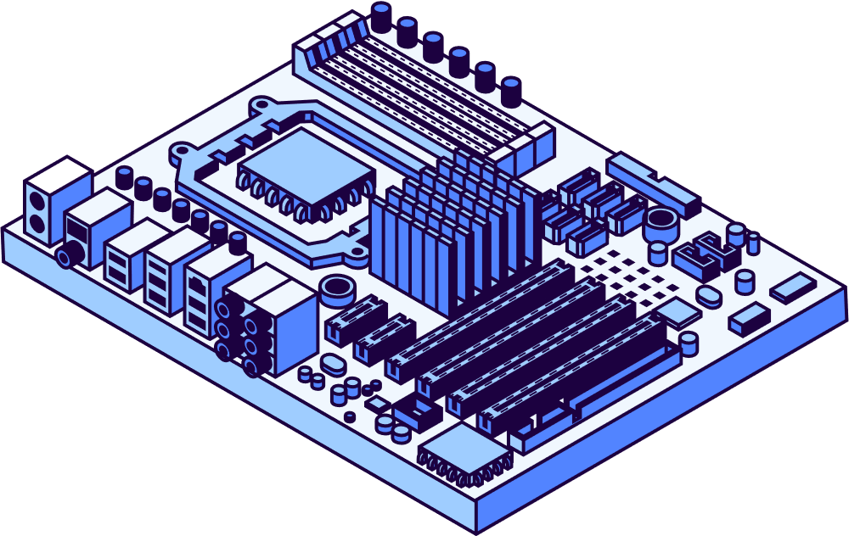




















TECHNICAL APPROACH
@XEN!TH
DATA INPUT LAYER
CCTV
Feeds
IOT
Sensors
V2V
Devices
Citizen
App
Reports
PROCESSING LAYER ( ISTM ENGINE )
Data &
Backend Core
Storage &
Deployment
Frontend
& APIs
Yolov8
Vehicle
Detection
LSTM
Traffic
Forecasting
Open CV
Mongo DB
JS
Video
Processing
Python
AWS
Platform
HTML
YOLOv8
object detection
V2V / V2I
Admin
Dashboard
DECISION LAYER ( AI / ML )
Open CV
Mongo DB
JS
Adaptive
Signal
Controller
Emergency
vehicle
Priority
Eco-
Routing
logic
LSTM Traffic
forecasting
Sumo
simulation
Citizen
Web App
YOLOv8
object detection
V2V / V2I
Admin
Dashboard
LSTM Traffic
forecasting
Sumo
simulation
Citizen
Web App
APPLICATION LAYER
Dashboard
for authorities
Citizen
Web Application
@SIH Idea submission- Template
3
Notes:
3

Slide 4
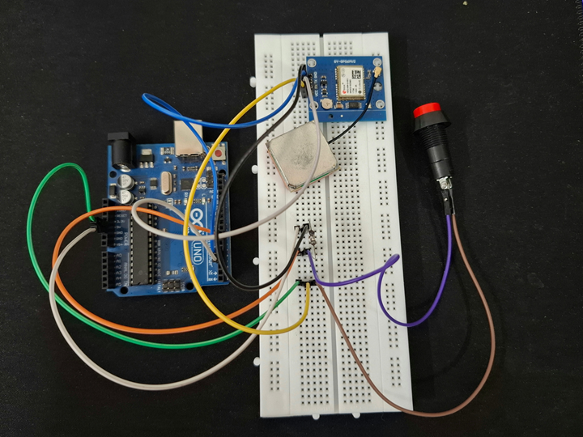
FEASIBILITY AND VIABILITY
@XEN!TH
Features
Delhi
ITMS
Pune
ATMS
Bengaluru BATCS
Marg Sarthi
Cost
High
Moderate-High
High
Lower / Moderate
Traffic Prediction
Reactive
Partial AI
Pilot AI
Predictive LSTM (2-4 km ahead)
Adaptive Signal
Rule-Based
Limited ML
AI-assisted pilot
ML-optimized , 20-30% throughput
Emergency Vehicle Priority Device:
Arduino + GPS + Button mounted on ambulance
Sends real-time location & emergency alert
Vehicles ahead get instant notification to clear path
Enables green corridor, faster response, low-cost solution
Incident Detection
Manual
Partial Camera
Limited
Automated OpenCV (accident/potholes/violations)
Emergency Vehicle Priority
Manual / Partial
Pilot
Limited
V2V Integration creates green corridors
Citizen / Eco Integeration
Minimal
Minimal
None
Mobile Reporting + Eco Routing
@SIH Idea submission- Template
4
Notes:
4

Slide 5
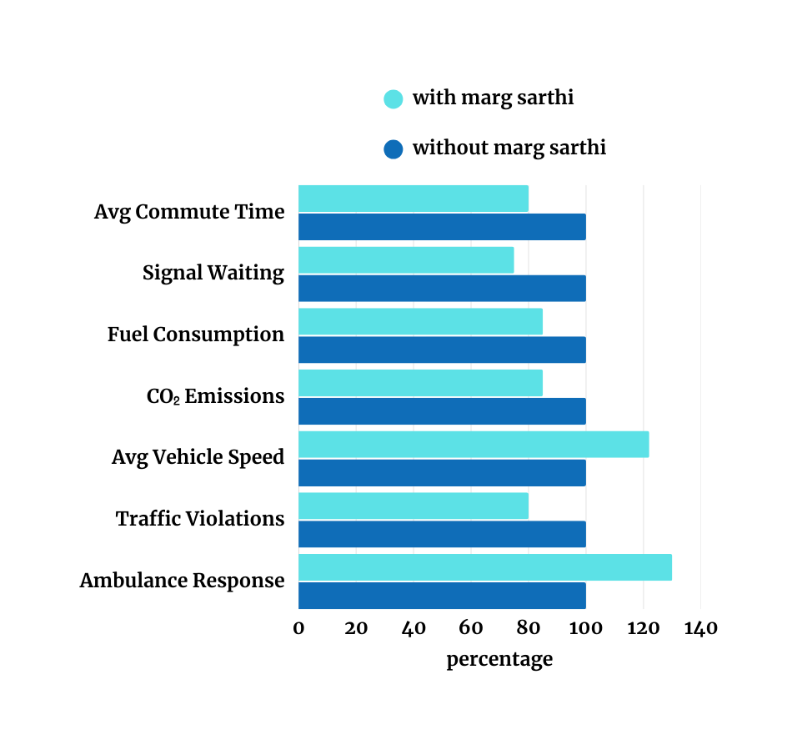
IMPACT AND BENEFITS
@XEN!TH
Traffic Efficiency
Average commute time reduced by 12–15% (validated using SUMO simulations).
Signal waiting time cut by 20–25% with adaptive signals.
Emergency Response
Ambulance clearance time improved by 25–30% with V2V-based green corridors.
Potential to save hundreds of lives annually in metro cities.
Road Safety & Maintenance
Violation detection improved by 40% vs manual enforcement.
Citizen reports enable pothole/blockage resolution 2× faster than current systems.
Environmental Benefits
Fuel wastage from idling reduced by 10%, saving crores annually.
CO₂ emissions cut by 8–12% in pilot simulations.
Citizen Engagement
Expected >70% resolution rate for citizen-reported issues.
Gamification can increase safe-driving participation by 15–20%
@SIH Idea submission- Template
5
Notes:
5

Slide 6
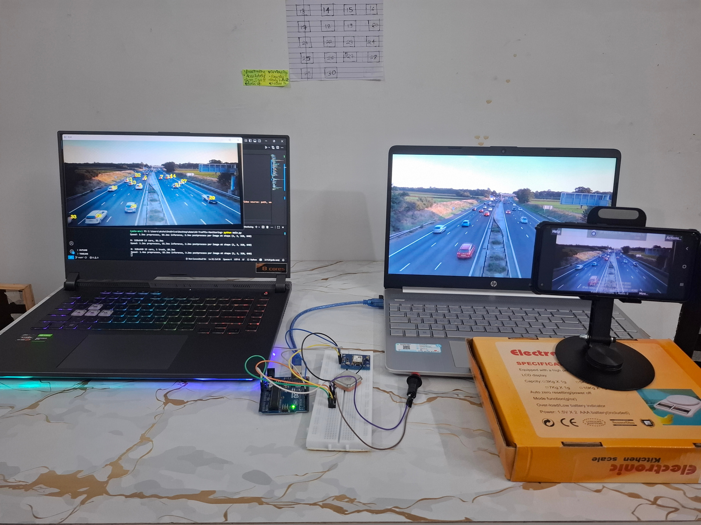
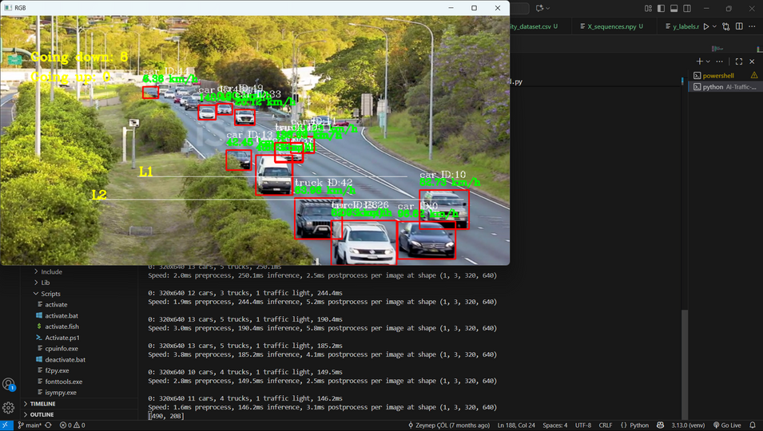
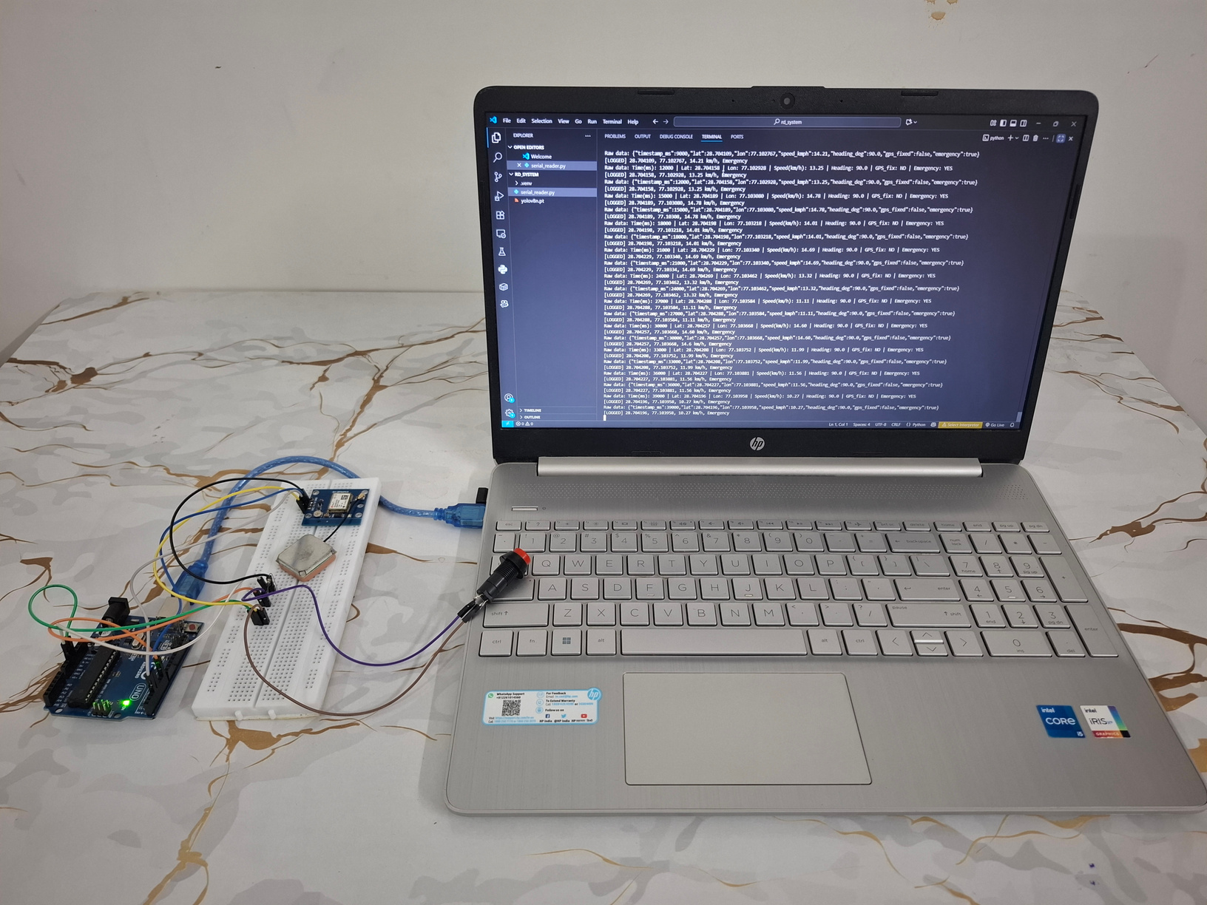
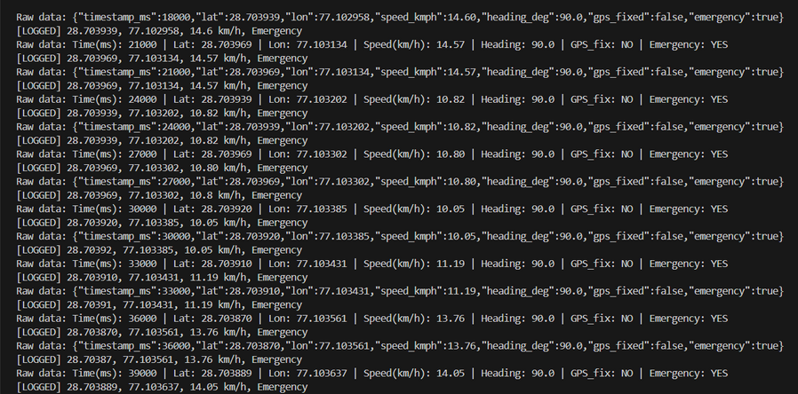
RESEARCH AND REFERENCES
@XEN!TH
REAL TIME TRAFFIC DETCTION SIMULATION
REFERENCES
https://www.newindianexpress.com/cities/delhi/2024/Nov/18/bumper-to-bumper-in-delhi
https://www.downtoearth.org.in/air/how-india-moves-planned-bhubaneswaris-growing-in-an-unplanned-fashion-but-there-is-room-for-improvement
https://www.sciencedirect.com/science/article/pii/S2772586325000048
https://bangaloremirror.indiatimes.com/bangalore/civic/stuck-in-the-traffic-heres-why/articleshow/117377844.cms
https://pure.rug.nl/ws/portalfiles/portal/50468219/1_s2.0_S0968090X17302681_main.pdf
https://crowplatform.com/wp-content/uploads/2024/04/D742_CROW_Document-iTLC-in-Sump_web-gecomprimeerd_1.pdf
https://timesofindia.indiatimes.com/city/hyderabad/no-end-in-sight-to-traffic-chaos-as-hyderabad-vehicle-count-nears-90-lakh/articleshow/123606999.cms
https://pmc.ncbi.nlm.nih.gov/articles/PMC8348605/
https://www.weforum.org/stories/2014/07/seven-ways-cities-around-world-tackling-traffic/
https://blog.goodvisionlive.com/6-smart-cities-that-get-traffic-control-rightxt
V2V DEVICE SIMULATION
FOR FURTHER
RESEARCH CLICK BELOW
https://drive.google.com/drive/folders/1CPMhk5GDlRxFjV0bizzQBii81tHvX7CX?usp=sharing
TEAM DETAILS
SHIVANI SHARMA [TL]
VISHAL KUMAR
ADITYA NARUKA
AKSHAT KUMAR ARYA
HIMANSHI BISHNOI
ADITYA GOYAL
@SIH Idea submission- Template
6
Notes:
6

